Slide 1
Undertaking the Long Term PASA
WEM Procedure
WRIG - 28 April 2022

Slide 2
Background
Long Term PASA is a Projected Assessment of System Adequacy (PASA) study conducted in accordance with clause 4.5 in order to determine the Reserve Capacity Target (RCT) for each year in the Long Term PASA Study Horizon and prepare the Statement of Opportunities Report for a Reserve Capacity Cycle.
Head of power for this Procedure is in clause 4.5.14 of the WEM Rules.

Slide 3
Key revisions
The revisions to the Procedure were for amendments made in:
Wholesale Electricity Market Amendment (Tranches 2 and 3 Amendments) Rules 2020.
Wholesale Electricity Market Amendment (Governance) Rules 2021.
Key revisions include:
Removing direct rule clause quotes.
Removing the Coordinator’s (previously ERA’s) review of the Planning Criterion (which is not required by the head of power clause).
Restructuring to reflect the current process used to forecast peak demand and complete the reliability assessment.

Slide 4
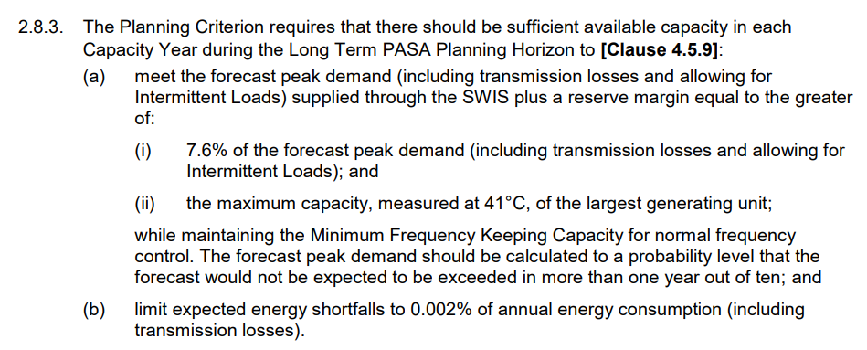
Removal of direct clause quotes
The Procedure originally frequently used direct clause quotes:
The revised Procedure avoids direct clause quotes and refers to clause numbers where needed.

Slide 5
Restructuring the Procedure
The Procure was restructured to improve the clarity of the process for AEMO to conduct the Long Term PASA, covering the following key aspects:
Information requests
Preparation of operational consumption and demand forecasts
Reserve Capacity Target assessment
Availability Curves
Availability Classes requirement

Slide 6
Removal of the review of the Planning Criterion
The Procedure originally covered the process that the Economic Regulation Authority (ERA) must follow in conducting the review of the Planning Criterion.
The revised Procedure removed the process associated with the review of the Planning Criterion:
From 1 July 2021, responsibility for the review of the Planning Criterion was transferred from the ERA to the Coordinator of Energy.
The head of power clause 4.5.14 was amended and no longer requires to include the review of Planning Criterion.

Slide 7
Questions and consultation information
Consultation:
Procedure expected to be published for consultation by mid-May.
15 Business Days consultation period.
The Procedure is scheduled to commence on 1 July 2022.
Additional comments or questions can be directed to AEMO by email to WA.ETS@aemo.com.au.

