Slide 2
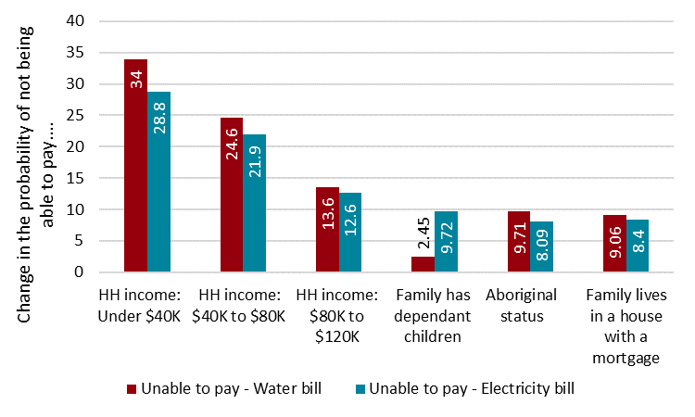
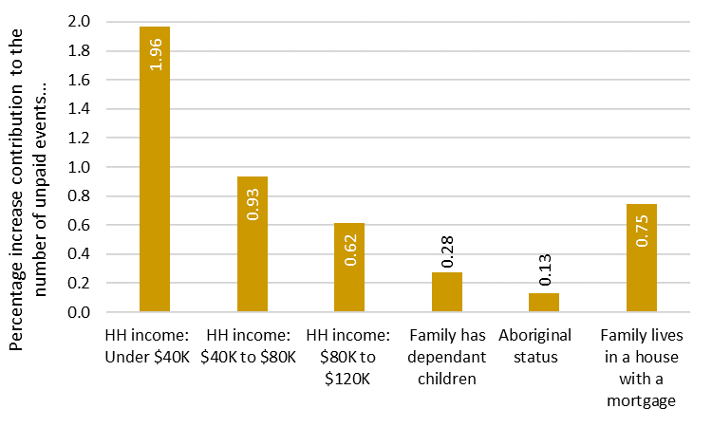
Contributors to households’ inability to pay for bills, household characteristics
Source: Graham Hansen, Eva Perroni and Dr Silvia Salazar (2022) Understanding Utility Hardship, Western Australian Council of Social Service and Bankwest Curtin Economics Centre.

Slide 3
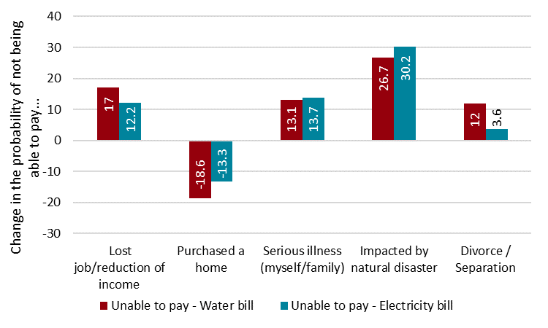
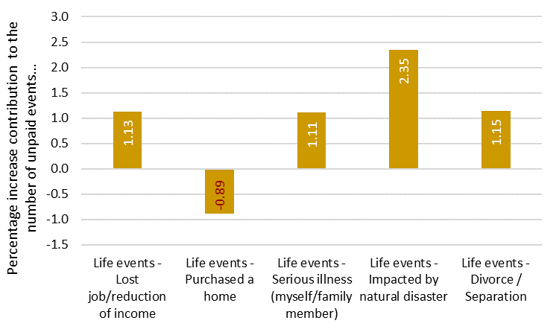
Contributors to household's inability to pay for bills, life events
Source: Graham Hansen, Eva Perroni and Dr Silvia Salazar (2022) Understanding Utility Hardship, Western Australian Council of Social Service and Bankwest Curtin Economics Centre.

Slide 4
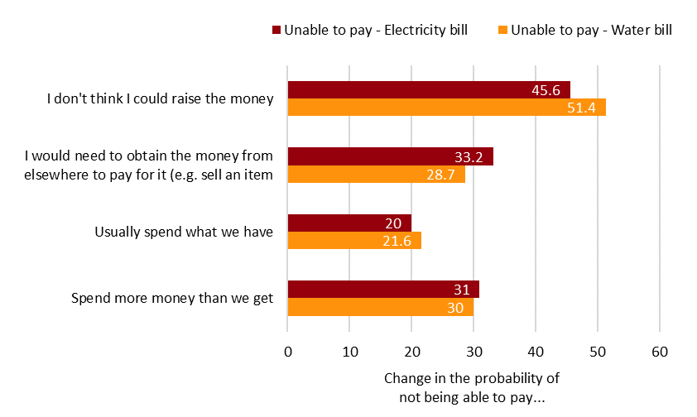
Contributors to household's inability to pay for bills, savings and financial management
Source: Graham Hansen, Eva Perroni and Dr Silvia Salazar (2022) Understanding Utility Hardship, Western Australian Council of Social Service and Bankwest Curtin Economics Centre.

Slide 5
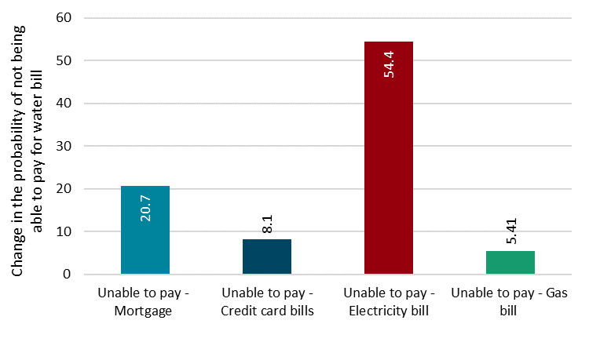
Contributors to household's inability to pay for bills, co-dependency with other bills
Source: Graham Hansen, Eva Perroni and Dr Silvia Salazar (2022) Understanding Utility Hardship, Western Australian Council of Social Service and Bankwest Curtin Economics Centre.

Slide 6
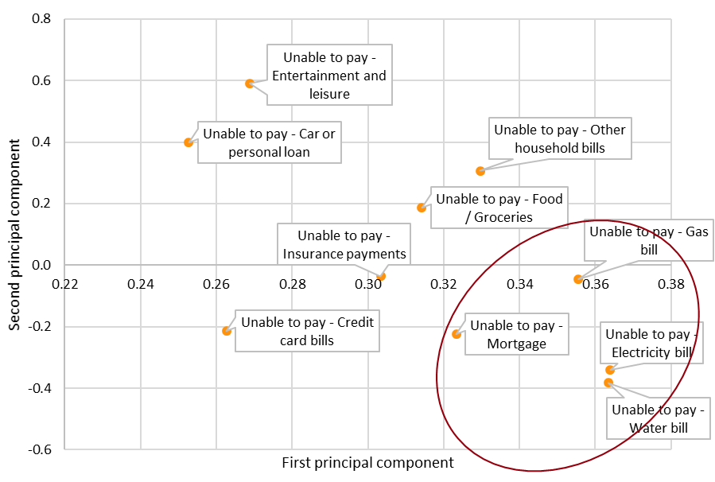
Principal component analysis, inability to pay different bills
Source: Graham Hansen, Eva Perroni and Dr Silvia Salazar (2022) Understanding Utility Hardship, Western Australian Council of Social Service and Bankwest Curtin Economics Centre.

Slide 7
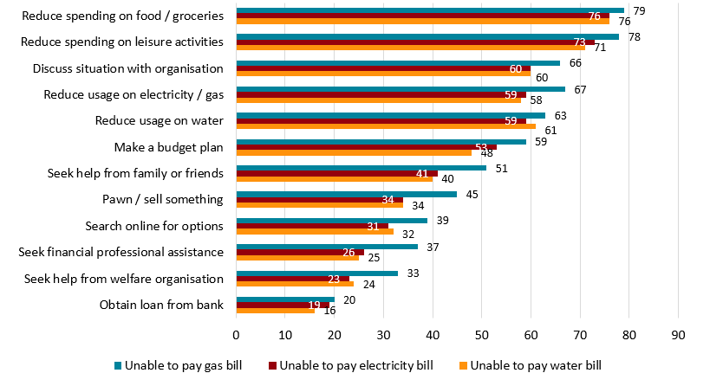
Coping mechanisms by type of utility bill unable to be paid, %
Source: Graham Hansen, Eva Perroni and Dr Silvia Salazar (2022) Understanding Utility Hardship, Western Australian Council of Social Service and Bankwest Curtin Economics Centre.

Slide 8
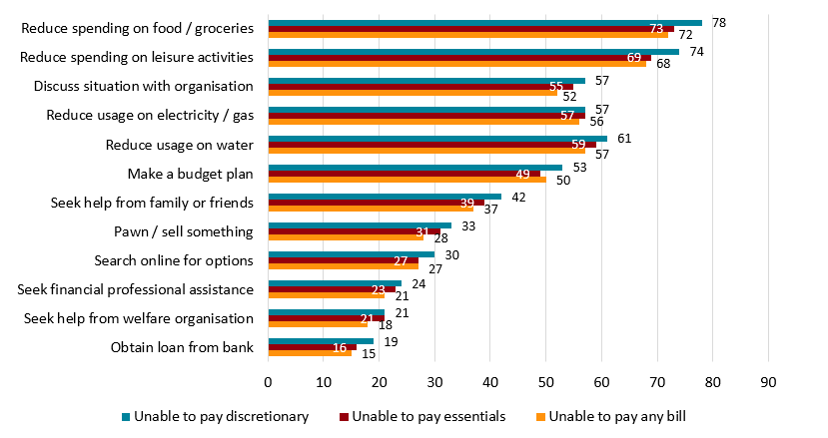
Coping mechanisms by discretionary or essential bill unable to be paid, %
Source: Graham Hansen, Eva Perroni and Dr Silvia Salazar (2022) Understanding Utility Hardship, Western Australian Council of Social Service and Bankwest Curtin Economics Centre.

Slide 9
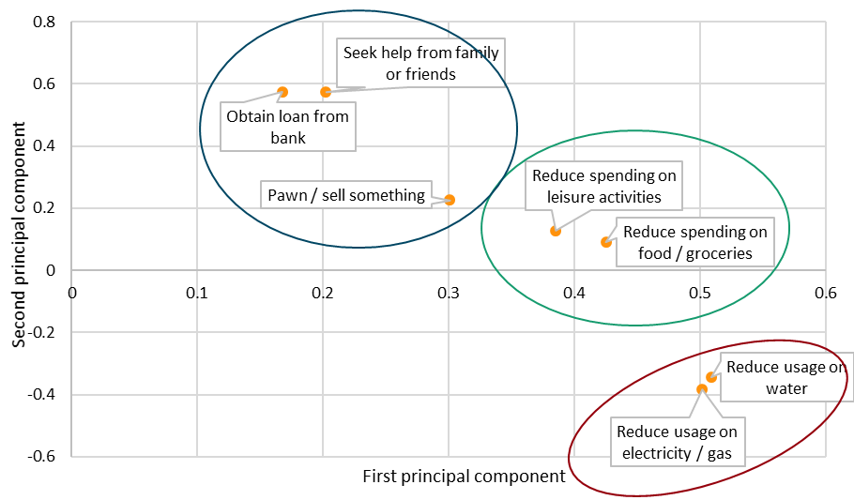
Principle component analysis, multiple coping strategies
Source: Graham Hansen, Eva Perroni and Dr Silvia Salazar (2022) Understanding Utility Hardship, Western Australian Council of Social Service and Bankwest Curtin Economics Centre.

Slide 10
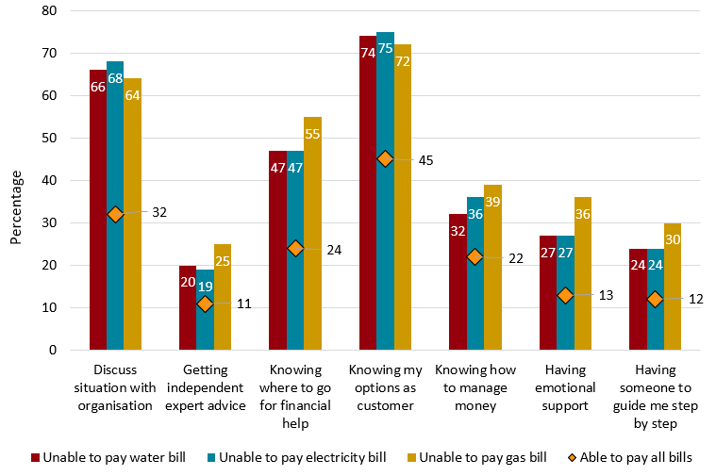
What would be most helpful by type of utility bill unable to be paid
Source: Graham Hansen, Eva Perroni and Dr Silvia Salazar (2022) Understanding Utility Hardship, Western Australian Council of Social Service and Bankwest Curtin Economics Centre.

Slide 11
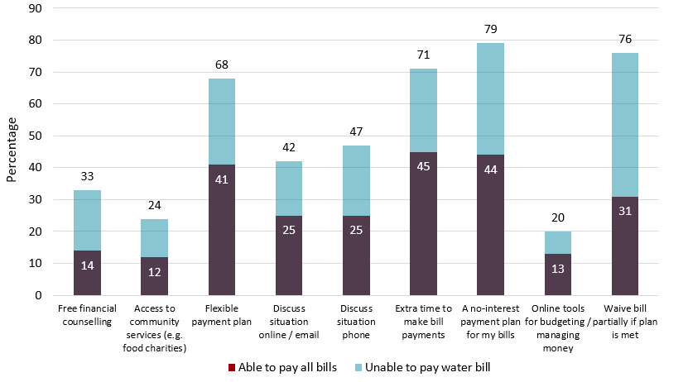
Types of assistance that would be most useful
Source: Graham Hansen, Eva Perroni and Dr Silvia Salazar (2022) Understanding Utility Hardship, Western Australian Council of Social Service and Bankwest Curtin Economics Centre.

Slide 12
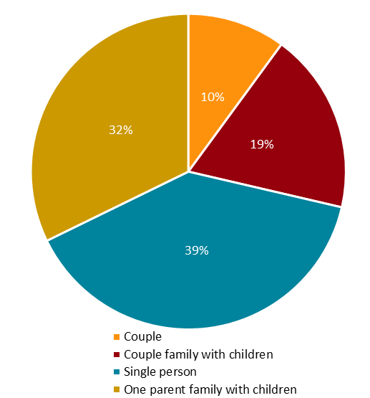
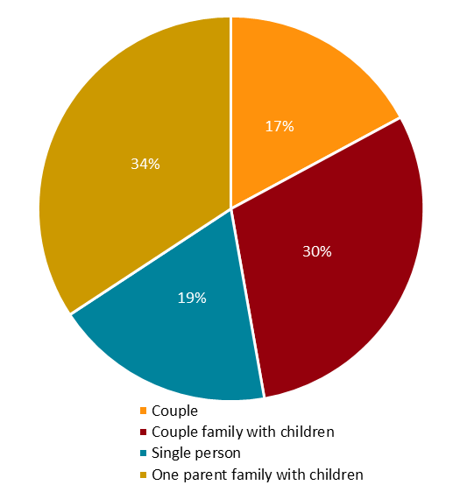
Family type, FCN and Customer Survey
Family type, FCN Family type, Customer Survey
Source: Graham Hansen, Eva Perroni and Dr Silvia Salazar (2022) Understanding Utility Hardship, Western Australian Council of Social Service and Bankwest Curtin Economics Centre.

Slide 13
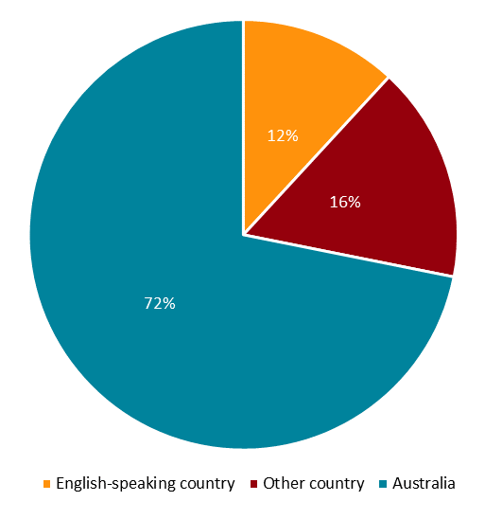
Clients’ country of origin, FCN
Source: Graham Hansen, Eva Perroni and Dr Silvia Salazar (2022) Understanding Utility Hardship, Western Australian Council of Social Service and Bankwest Curtin Economics Centre.

Slide 14
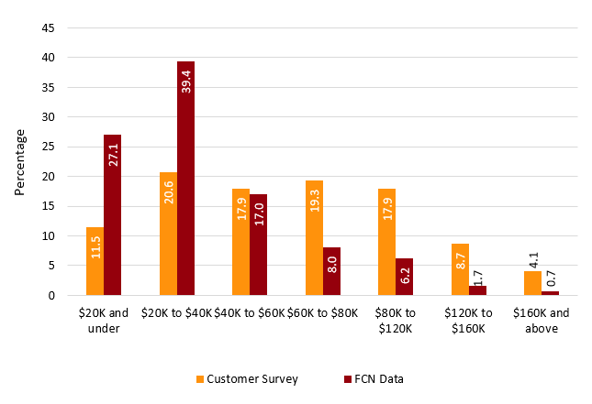
Household income, FCN and Water Corporation
Source: Graham Hansen, Eva Perroni and Dr Silvia Salazar (2022) Understanding Utility Hardship, Western Australian Council of Social Service and Bankwest Curtin Economics Centre.

Slide 15
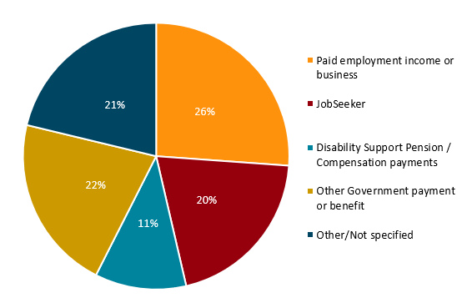
Main source of income, FCN
Source: Graham Hansen, Eva Perroni and Dr Silvia Salazar (2022) Understanding Utility Hardship, Western Australian Council of Social Service and Bankwest Curtin Economics Centre.

Slide 16
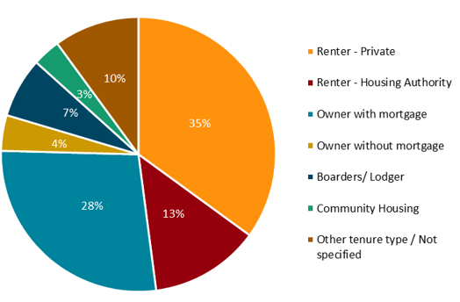
Home ownership type, FCN
Source: Graham Hansen, Eva Perroni and Dr Silvia Salazar (2022) Understanding Utility Hardship, Western Australian Council of Social Service and Bankwest Curtin Economics Centre.

Slide 17
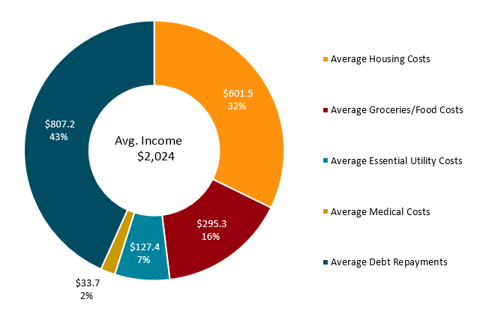
Fortnightly expenditure patterns, FCN
Source: Graham Hansen, Eva Perroni and Dr Silvia Salazar (2022) Understanding Utility Hardship, Western Australian Council of Social Service and Bankwest Curtin Economics Centre.

Slide 18
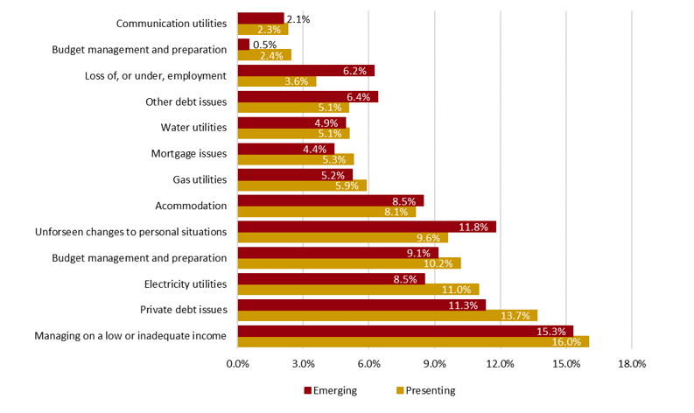
Reasons for accessing FCN services
Note: ‘Presenting’ reasons are those that the client presented with or disclosed during the initial intake into the service, while ‘emerging’ reasons are those that emerged during subsequent meetings or assessments by the financial counsellor.
Source: Graham Hansen, Eva Perroni and Dr Silvia Salazar (2022) Understanding Utility Hardship, Western Australian Council of Social Service and Bankwest Curtin Economics Centre.

Slide 19
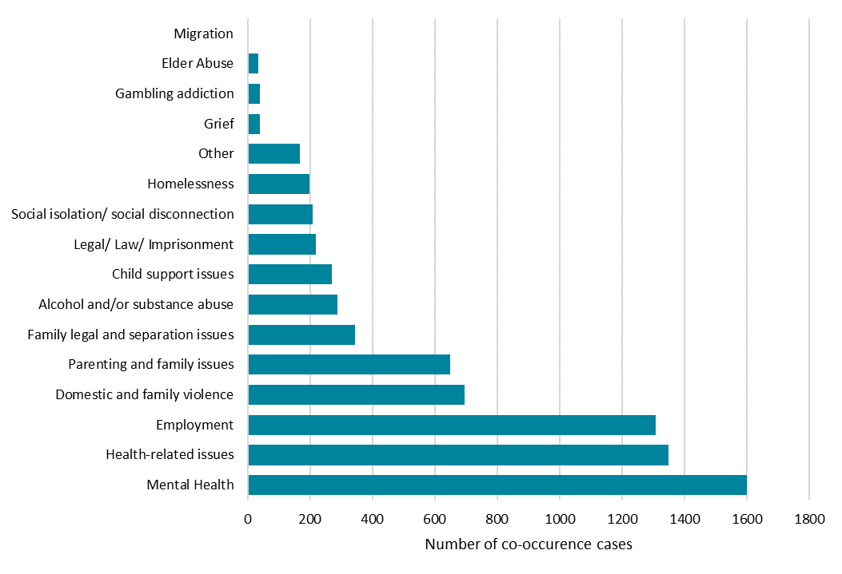
Co-occurring issues with financial hardship, FCN
Source: Graham Hansen, Eva Perroni and Dr Silvia Salazar (2022) Understanding Utility Hardship, Western Australian Council of Social Service and Bankwest Curtin Economics Centre.

